Slide 1


CHAPTER 10 REAL-WORLD PROTOCOLS
SSH
SECURE SOCKET LAYER
IPSEC
KERBEROS
CHAPTER 10 REAL WORLD SECURITY PROTOCOLS PREPARED BY: DR. MUHAMMAD IQBAL HOSSAIN
‹#›

Slide 2
REAL TIME SECURITY COMM
Real time protocol
The parties negotiate interactively to authenticate each other and establish a session key
Security Association (SA)
The conversation protected with that session key
‹#›
CHAPTER 10 REAL WORLD SECURITY PROTOCOLS PREPARED BY: DR. MUHAMMAD IQBAL HOSSAIN

Slide 3
REAL-WORLD PROTOCOLS
Next, we’ll look at specific protocols
SSH ⎯ a simple & useful security protocol
SSL ⎯ practical security on the Web
IPSec ⎯ security at the IP layer
Kerberos ⎯ symmetric key, single sign-on
WEP ⎯ “Swiss cheese” of security protocols
GSM ⎯ mobile phone (in)security
CHAPTER 10 REAL WORLD SECURITY PROTOCOLS PREPARED BY: DR. MUHAMMAD IQBAL HOSSAIN
‹#›

Slide 4

SECURE SHELL (SSH)
CHAPTER 10 REAL WORLD SECURITY PROTOCOLS PREPARED BY: DR. MUHAMMAD IQBAL HOSSAIN
‹#›

Slide 5
SSH
Creates a “secure tunnel”
Insecure command sent thru SSH tunnel are then secure
SSH used with things like rlogin
Why is rlogin insecure without SSH?
Why is rlogin secure with SSH?
SSH is very simple protocol
CHAPTER 10 REAL WORLD SECURITY PROTOCOLS PREPARED BY: DR. MUHAMMAD IQBAL HOSSAIN
‹#›
Notes:
log into a remote machine over a network. Such a login typically requires a password and rlogin simply sends the password in the clear, which might be observed by a snooping Trudy.
By first establishing an SSH session, any inherently insecure command such as rlogin will be secure. That is, an SSH session provides confidentiality and integrity protection, thereby eliminating Trudy's ability to obtain passwords and other confidential information that would otherwise be sent unprotected.

Slide 6
SSH
SSH authentication can be based on…
Public keys, or
Digital certificates, or
Passwords
Here, we consider certificate mode
Other modes in homework problems
We consider slightly simplified SSH…
‹#›
CHAPTER 10 REAL WORLD SECURITY PROTOCOLS PREPARED BY: DR. MUHAMMAD IQBAL HOSSAIN

Slide 7
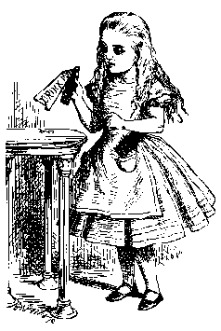
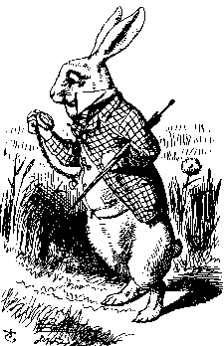
SIMPLIFIED SSH
Alice, CP, R_{A}
CS, R_{B}
gª mod p
g^{b} mod p, certificate_{B}, S_{B}
Alice
Bob
E(Alice, certificate_{A}, S_{A}, K)
CP = “crypto proposed”, and CS = “crypto selected”
H = h(Alice,Bob,CP,CS,R_{A},R_{B},gª mod p,g^{b} mod p,g^{ab} mod p)
S_{B} = [H]_{Bob}
S_{A} = [H, Alice, certificate_{A}]_{Alice}
K = g^{ab} mod p
‹#›
CHAPTER 10 REAL WORLD SECURITY PROTOCOLS PREPARED BY: DR. MUHAMMAD IQBAL HOSSAIN
Notes:
Alice identifies herself and she sends information regarding the crypto parameters that she prefers (crypto algorithms, key lengths, etc.), along with her nonce, RA.
In message two, Bob selects from Alice's crypto parameters and returns his selections, along with his nonce, RB.
Alice sends her Diffie-Hellman value
Bob responds with his Diffie-Hellman value, his certificate, and SB, which consists of a signed hash value.
At this point, Alice is able to compute the key K, and in the final message, she sends an encrypted block that contains her identity, her certificate, and her signed value SA
The signatures are intended to provide mutual authentication. Note that the nonce RA is Alice's challenge to Bob, and SB is Bob's response. That is, the nonce RA provides replay protection, and only Bob can give the correct response since a signature is required (assuming, of course, that his private key has not been compromised). A similar argument shows that Alice is authenticated in the final message. So, SSH provides mutual authentication.
‹#›

Slide 8
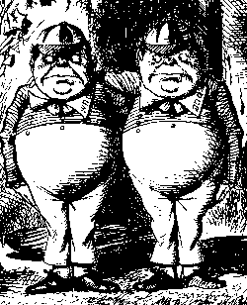
MIM ATTACK ON SSH?
Alice, R_{A}
Alice, R_{A}
R_{B}
R_{B}
gª mod p
g^{t} mod p
g^{t} mod p, cert_{B}, S_{B}
g^{b} mod p, cert_{B}, S_{B}
Alice
E(Alice,cert_{A},S_{A},K)
Trudy
E(Alice,cert_{A},S_{A},K)
Bob
Where does this attack fail?
Alice computes:
H_{a} = h(Alice,Bob,CP,CS,R_{A},R_{B},gª mod p,g^{t} mod p,g^{at} mod p)
But Bob signs:
H_{b} = h(Alice,Bob,CP,CS,R_{A},R_{B},g^{t} mod p,g^{b} mod p,g^{bt} mod p)
CHAPTER 10 REAL WORLD SECURITY PROTOCOLS PREPARED BY: DR. MUHAMMAD IQBAL HOSSAIN
‹#›
Notes:
Bob can attack but its of no use. The authentication failed.

Slide 9


SECURE SOCKET LAYER
‹#›
CHAPTER 10 REAL WORLD SECURITY PROTOCOLS PREPARED BY: DR. MUHAMMAD IQBAL HOSSAIN
Notes:
http
…socket layer
tcp
"socket layer" lives between the application layer and the transport layer in the Internet protocol stack, as illustrated in Figure 10.2. In practice,
‹#›

Slide 10
SOCKET LAYER
“Socket layer” lives between application and transport layers
SSL usually lies between HTTP (application) and TCP (transport)
application
transport
network
link
physical
User
Socket
“layer”
OS
NIC
CHAPTER 10 REAL WORLD SECURITY PROTOCOLS PREPARED BY: DR. MUHAMMAD IQBAL HOSSAIN
‹#›
Notes:
SSL most often deals with Web browsing, in which case the application layer protocol is HTTP and the transport layer protocol is TCP.
‹#›

Slide 11
WHAT IS SSL?
SSL is the protocol used for majority of secure transactions over the Internet
For example, if you want to buy a book at amazon.com…
You want to be sure you are dealing with Amazon (authentication)
Your credit card information must be protected in transit (confidentiality and/or integrity)
As long as you have money, Amazon doesn’t care who you are (authentication need not be mutual)
CHAPTER 10 REAL WORLD SECURITY PROTOCOLS PREPARED BY: DR. MUHAMMAD IQBAL HOSSAIN
‹#›

Slide 12
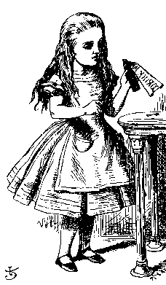
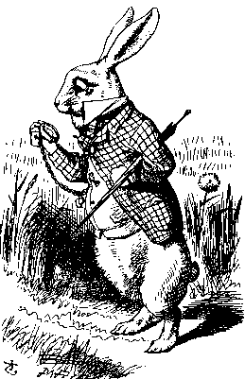
SIMPLE SSL-LIKE PROTOCOL
I’d like to talk to you securely
Here’s my certificate
{K_{AB}}_{Bob}
Alice
protected HTTP
Bob
Is Alice sure she’s talking to Bob?
Is Bob sure he’s talking to Alice?
CHAPTER 10 REAL WORLD SECURITY PROTOCOLS PREPARED BY: DR. MUHAMMAD IQBAL HOSSAIN
‹#›
Notes:
2. Certificate have public key, identity, signed by CA. So Alice trust its bob.
3. Then Alice will encrypt a symmetric key KAB with Bob's public key and send the encrypted key to Bob. This symmetric key is used to encrypt and integrity protect subsequent communications.
Here is no authentication.

Slide 13
SIMPLIFIED SSL PROTOCOL
Can we talk?, cipher list, R_{A}
Certificate, cipher, R_{B}
{S}_{Bob}, E(h(msgs,CLNT,K),K)
h(msgs,SRVR,K)
Alice
Data protected with key K
Bob
S is pre-master secret
K = h(S,R_{A},R_{B})
msgs = all previous messages
CLNT and SRVR are constants
‹#›
CHAPTER 10 REAL WORLD SECURITY PROTOCOLS PREPARED BY: DR. MUHAMMAD IQBAL HOSSAIN
Notes:
Alice informs Bob that she would like to establish an SSL connection, and she passes a list of ciphers that she supports, along with a nonce RA.
Bob responds with his certificate, he selects one of the ciphers from the cipher list that Alice sent in message one, and he sends a nonce RB.
Alice sends the so-called pre-master secret S, which she randomly generated, along with a hash that is encrypted with the key K. In this hash, "msgs" includes all previous messages and CLNT is a literal string. Why hash is used? Because the hash is used as an integrity check to verify that the previous messages have been received correctly.
Bob responds with a similar hash. By computing this hash herself, Alice can verify that Bob received the messages correctly, and she can authenticate Bob, since only Bob could have decrypted S, which is required to generate the key K. At this point, Alice has authenticated Bob, and Alice and Bob have established a shared session key K, which they can use to encrypt and integrity protect subsequent messages.
Bob cannot authenticate Alice.

Slide 14
SSL KEYS
6 “keys” derived from K = hash(S,R_{A},R_{B})
2 encryption keys: send and receive
2 integrity keys: send and receive
2 IVs: send and receive
Why different keys in each direction?
Q: Why is h(msgs,CLNT,K) encrypted (and integrity protected)?
A: Apparently, it adds no security…
CHAPTER 10 REAL WORLD SECURITY PROTOCOLS PREPARED BY: DR. MUHAMMAD IQBAL HOSSAIN
‹#›
Notes:
In reality, more than one key is derived from the hash h(S,RA,RB)- In fact, the following six quantities are generated from this hash.
Why we need this? Trudy can

Slide 15
SSL AUTHENTICATION
Alice authenticates Bob, not vice-versa
How does client authenticate server?
Why does server not authenticate client?
Mutual authentication is possible: Bob sends certificate request in message 2
This requires client to have certificate
If server wants to authenticate client, server could instead require (encrypted) password
CHAPTER 10 REAL WORLD SECURITY PROTOCOLS PREPARED BY: DR. MUHAMMAD IQBAL HOSSAIN
‹#›
Notes:
Everybody need CA for client. Why bother?

Slide 16
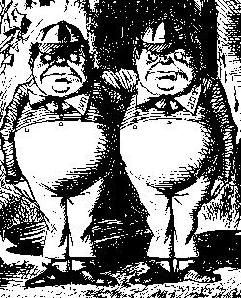
SSL MIM ATTACK
R_{A}
R_{A}
certificate_{T}, R_{B}
certificate_{B}, R_{B}
{S₁}_{Trudy}, E(X₁,K₁)
{S₂}_{Bob}, E(X₂,K₂)
h(Y₁,K₁)
h(Y₂,K₂)
Alice
E(data,K₁)
Trudy
E(data,K₂)
Bob
Q: What prevents this MiM attack?
A: Bob’s certificate must be signed by a certificate authority (such as Verisign)
What does Web browser do if sig. not valid?
What does user do if signature is not valid?
‹#›
CHAPTER 10 REAL WORLD SECURITY PROTOCOLS PREPARED BY: DR. MUHAMMAD IQBAL HOSSAIN
Notes:
Who verify the certificate? does Alice check the certificate by herself? NO, the browser does that.
What Alice do, she ignore the message and accept the consequences and say i agree. It opens the door for trudy.

Slide 17
https://blog.hubspot.com/website/fix-ssl-certificate-error

Slide 18
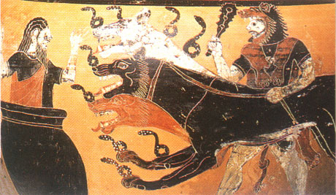
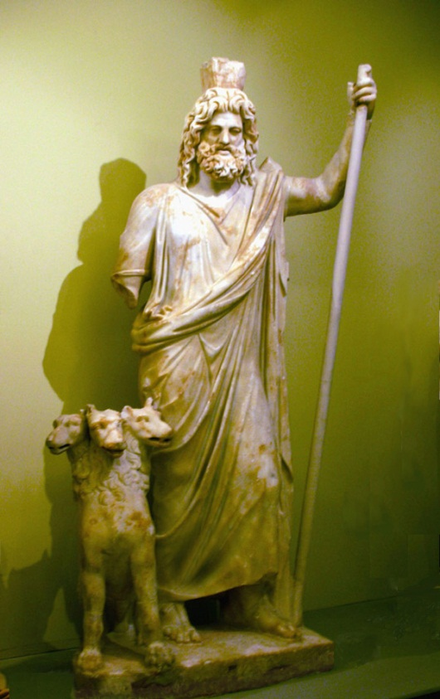
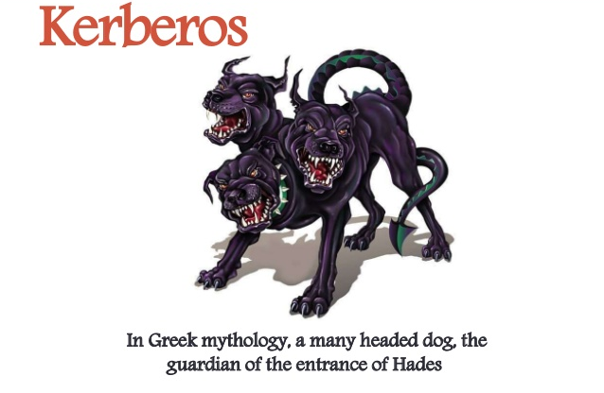
KERBEROS
‹#›
Notes:
Kerberos (/ˈkɜːrbərɒs/) is a computer-network authentication protocol that works on the basis of tickets to allow nodes communicating over a non-secure network to prove their identity to one another in a secure manner. The protocol was named after the character Kerberos (or Cerberus) from Greek mythology, the ferocious three-headed guard dog of Hades. Its designers aimed it primarily at a client–server model and it provides mutual authentication—both the user and the server verify each other's identity. Kerberos protocol messages are protected against eavesdropping and replay attacks.

Slide 19
Usages of Kerberos
Kerberos is used to authenticate entities requesting access to network resources, especially in large networks to support SSO. The protocol is used by default in many widely used networking systems. Some systems in which Kerberos support is incorporated or available include the following:
Amazon Web Services
Apple macOS
Google Cloud
Hewlett Packard Unix
IBM Advanced Interactive eXecutive
Microsoft Azure
Microsoft Windows Server and AD
Oracle Solaris
Red Hat Linux
FreeBSD
OpenBSD

Slide 20
KERBEROS
In Greek mythology, Kerberos is 3-headed dog that guards entrance to Hades
“Wouldn’t it make more sense to guard the exit?”
In security, Kerberos is an authentication system based on symmetric key crypto
Originated at MIT
Based on work by Needham and Schroeder
Relies on a Trusted Third Party (TTP)
‹#›
CHAPTER 10 REAL WORLD SECURITY PROTOCOLS PREPARED BY: DR. MUHAMMAD IQBAL HOSSAIN
Notes:
Works in local network
Symmetric key and timestamp

Slide 21
MOTIVATION FOR KERBEROS
Authentication using public keys
N users ⇒ N key pairs
Authentication using symmetric keys
N users requires about N² keys
Symmetric key case does not scale!
Kerberos based on symmetric keys but only requires N keys for N users
But must rely on TTP
Advantage is that no PKI is required
CHAPTER 10 REAL WORLD SECURITY PROTOCOLS PREPARED BY: DR. MUHAMMAD IQBAL HOSSAIN
‹#›
Notes:
Setup a system with N user. Everybody need to have their own public, private key.
Everybody need to share their key with others.
If I want to talk to you, we both go to the TTP for sharing session key and authenticate each other

Slide 22
KERBEROS KDC
Kerberos Key Distribution Center or KDC
Acts as a TTP
TTP must not be compromised!
KDC shares symmetric key K_{A} with Alice, key K_{B} with Bob, key K_{C} with Carol, etc.
Master key K_{KDC} known only to KDC
KDC enables authentication and session keys
Keys for confidentiality and integrity
In practice, the crypto algorithm used is DES
‹#›
CHAPTER 10 REAL WORLD SECURITY PROTOCOLS PREPARED BY: DR. MUHAMMAD IQBAL HOSSAIN

Slide 23
KERBEROS TICKETS
KDC issues a ticket containing info needed to access a network resource
KDC also issues ticket-granting tickets or TGTs that are used to obtain tickets
Each TGT contains
Session key
User’s ID
Expiration time
Every TGT is encrypted with K_{KDC}
TGT can only be read by the KDC
CHAPTER 10 REAL WORLD SECURITY PROTOCOLS PREPARED BY: DR. MUHAMMAD IQBAL HOSSAIN
‹#›
Notes:
Master ticket is TGT
Simple ticket.
TGT->KDC->TTP
KDC dnt need to remember.

Slide 24
KERBERIZED LOGIN
Alice enters her password
Alice’s workstation
Derives K_{A} from Alice’s password
Uses K_{A} to get TGT for Alice from the KDC
Alice can then use her TGT (credentials) to securely access network resources
Plus: Security is transparent to Alice
Minus: KDC must be secure --- it’s trusted!
CHAPTER 10 REAL WORLD SECURITY PROTOCOLS PREPARED BY: DR. MUHAMMAD IQBAL HOSSAIN
‹#›

Slide 25
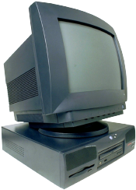

KERBERIZED LOGIN
Alice wants
Alice’s
a TGT
password
E(S_{A},TGT, K_{A})
Alice
Computer
KDC
Kerberos used for authentication
Key K_{A} derived from Alice’s password
KDC creates session key S_{A}
Workstation decrypts S_{A}, TGT, forgets K_{A}
TGT = E(“Alice”, S_{A}, K_{KDC})
‹#›
CHAPTER 10 REAL WORLD SECURITY PROTOCOLS PREPARED BY: DR. MUHAMMAD IQBAL HOSSAIN
Notes:
As on most systems, Alice first enters her username and password. In Kerberos, Alice's computer then derives the key KA from Alice's password, where KA is the key that Alice and the KDC share. Alice's computer uses KA to obtain Alice's TGT from the KDC.
Alice can then use her TGT (i.e., her credentials) to securely access network
resources. Once Alice has logged in, all of the security is automatic and takes
place behind the scenes, without any additional involvement by Alice.

Slide 26
ALICE REQUESTS TICKET TO BOB
I want to
talk to Bob
Talk to Bob
REQUEST
REPLY
Alice
Computer
KDC
REQUEST = (TGT, authenticator) where
authenticator = E(timestamp, S_{A})
REPLY = E(“Bob”, K_{AB}, ticket to Bob, S_{A})
ticket to Bob = E(“Alice”, K_{AB}, K_{B})
KDC gets S_{A} from TGT to verify timestamp
‹#›
CHAPTER 10 REAL WORLD SECURITY PROTOCOLS PREPARED BY: DR. MUHAMMAD IQBAL HOSSAIN
Notes:
suppose that Alice wants to talk to Bob. Then Alice's computer presents its TGT to the KDC, along with an authenticator. The authenticator is an encrypted timestamp that serves to avoid a replay. After the KDC verifies Alice's authenticator, it responds with a "ticket to Bob." Alice's computer then uses this ticket to Bob to securely communicate directly with Bob's computer.

Slide 27
ALICE USES TICKET TO BOB
ticket to Bob, authenticator
E(timestamp + 1,K_{AB})
Alice’s
Computer
Bob
ticket to Bob = E(“Alice”, K_{AB}, K_{B})
authenticator = E(timestamp, K_{AB})
Bob decrypts “ticket to Bob” to get K_{AB} which he then uses to verify timestamp
‹#›
CHAPTER 10 REAL WORLD SECURITY PROTOCOLS PREPARED BY: DR. MUHAMMAD IQBAL HOSSAIN
Notes:
Once Alice has obtained the "ticket to Bob," she can then securely communicate with Bob.

Slide 28
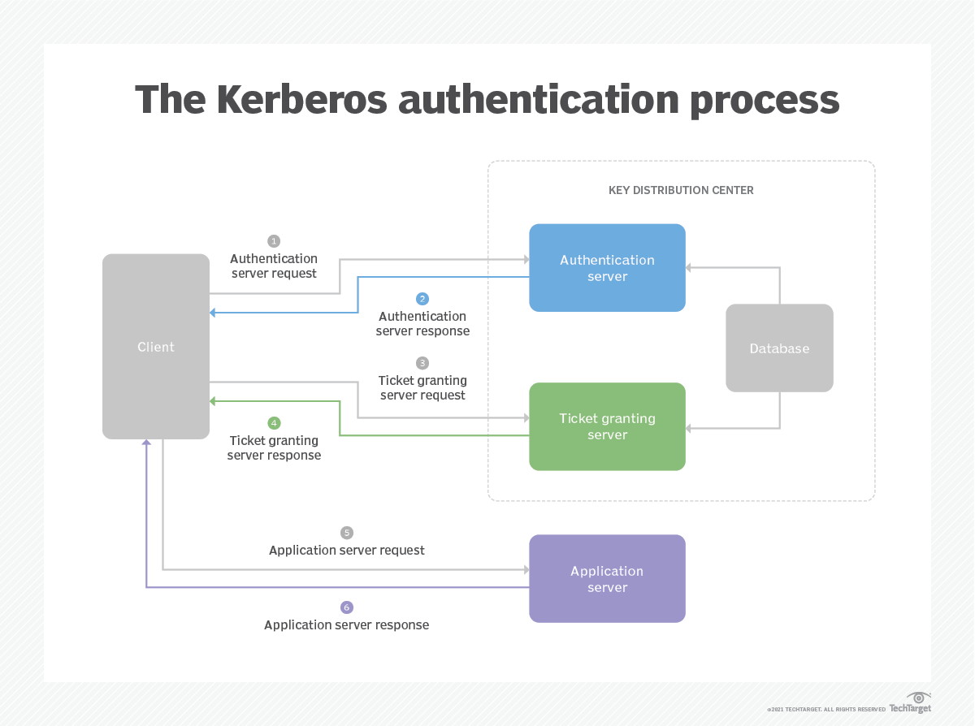

Slide 29
KERBEROS
Session key S_{A} used for
authentication
Can also be used for confidentiality/integrity
Timestamps used for
mutual authentication
Recall that timestamps reduce number of messages
Acts like a nonce that is known to both sides
Note: time is a security-critical parameter!
CHAPTER 10 REAL WORLD SECURITY PROTOCOLS PREPARED BY: DR. MUHAMMAD IQBAL HOSSAIN
‹#›

Slide 30
KERBEROS KEYS
In Kerberos, K_{A} = h(Alice’s password)
Could instead generate random K_{A} and
Compute K_{h} = h(Alice’s password)
And workstation stores E(K_{A}, K_{h})
Then K_{A} need not change (on workstation or KDC) when Alice changes her password
This alternative approach is often used in applications (but not in Kerberos)
CHAPTER 10 REAL WORLD SECURITY PROTOCOLS PREPARED BY: DR. MUHAMMAD IQBAL HOSSAIN
‹#›

